Slide 1
Name of the experiment: Perform Phishing Attacks.
Dr. Abdullah-Al-Musa
(B.Sc(Hons) In Computing, M.Engg In Information System Security , PhD)
Department of Computer Science & Engineering
Bangladesh University of Business and Technology (BUBT)

Slide 2

Legal Disclaimer
In addition, this is teaching purpose the Lab exercise and this does not condone malicious behavior of any kind inside the Lab.
Your are on notice, that continuing and/or using this lab outside is your "own responsibility“ and test environment is considered malicious and is against the law such as Bangladesh Digital Security Act 2018 , Bangladesh Information and Communication Technology Act 2006 .
Dr.Abdullah© 2022 -- no content should be replicated and it is not allowed without express written permission.

Slide 3
Lab Work : Performing Phishing Attacks.

Slide 4
Phishing definition
Phishing is a cyber attack that uses disguised email as a weapon. The goal is to trick the email recipient into believing that the message is something they want or need — a request from their bank, for instance, or a note from someone in their company — and to click a link or download an attachment.

Slide 5
What really distinguishes phishing is the form the message takes: the attackers masquerade as a trusted entity of some kind, often a real or plausibly real person, or a company the victim might do business with. It's one of the oldest types of cyberattacks, dating back to the 1990s, and it's still one of the most widespread and pernicious, with phishing messages and techniques becoming increasingly sophisticated.

Slide 6
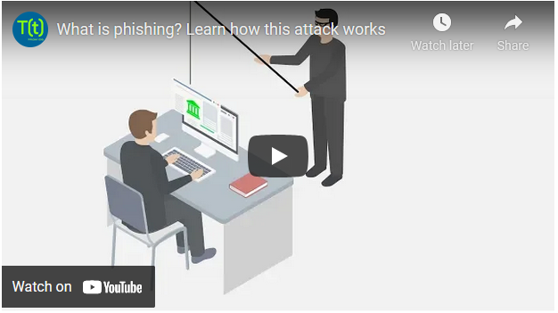

Slide 7
Step 1: Here opening two machine , so two machine are running in oracle virtual box .

Slide 8
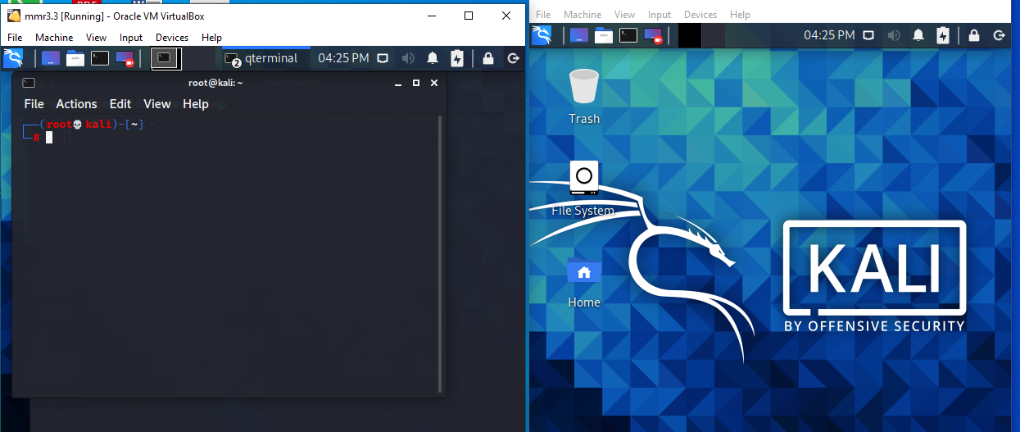

Slide 9
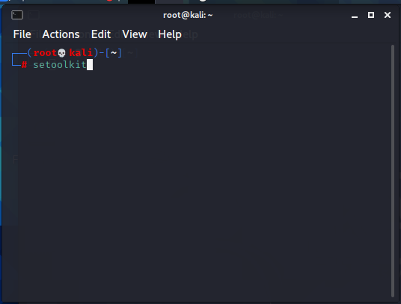

Slide 10
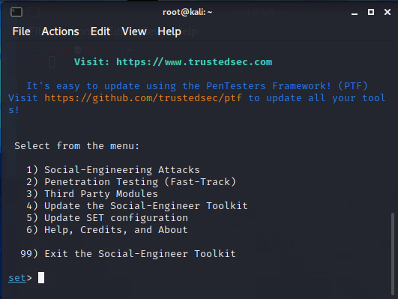

Slide 12
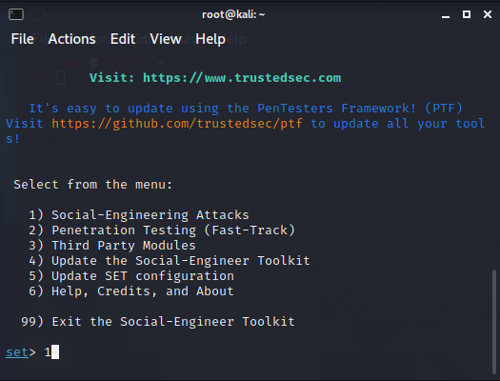

Slide 13
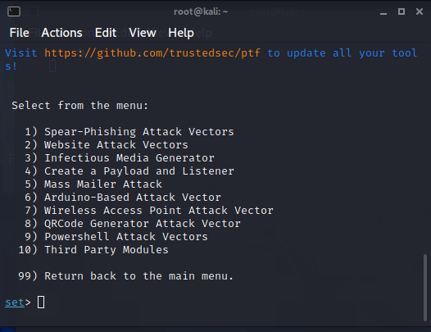

Slide 14
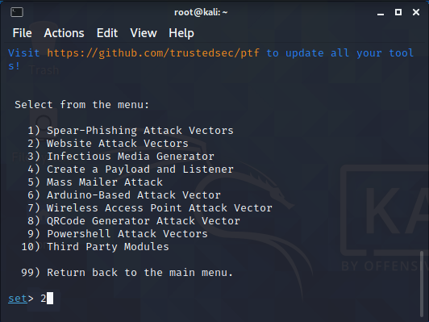

Slide 15
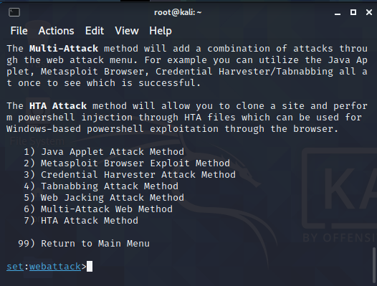

Slide 16
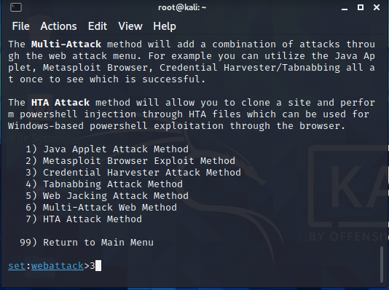

Slide 17
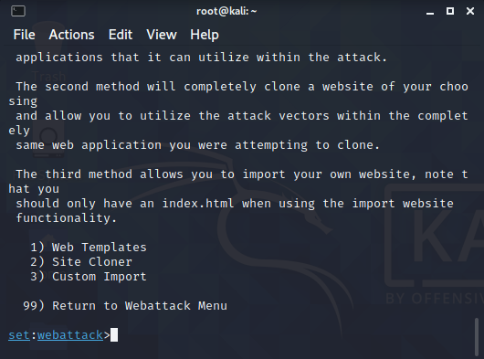

Slide 18
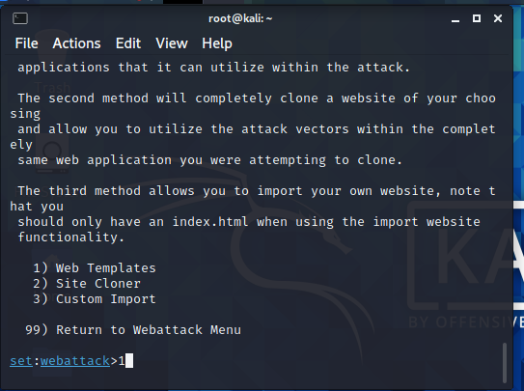

Slide 19
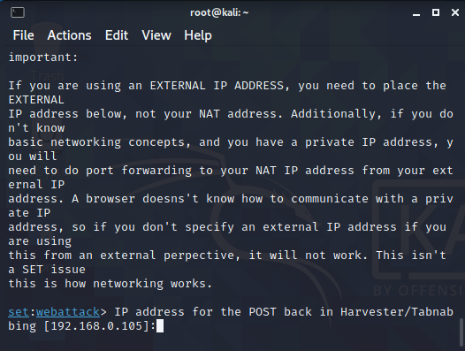

Slide 20
Now it is asking for ip address :

Slide 21
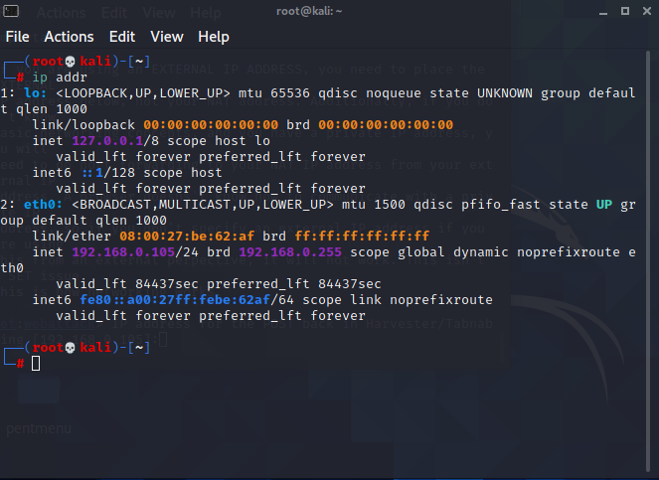

Slide 22
This is the listener ip address of the machine.

Slide 23
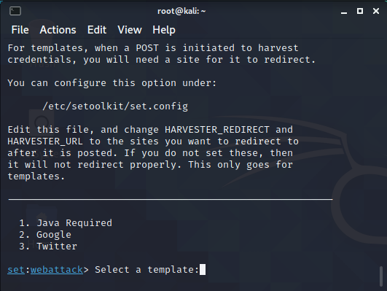

Slide 24


Slide 25
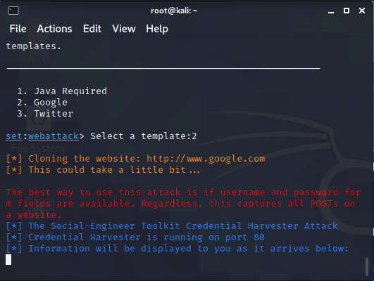

Slide 27
Now we will go to the victim machine .

Slide 28
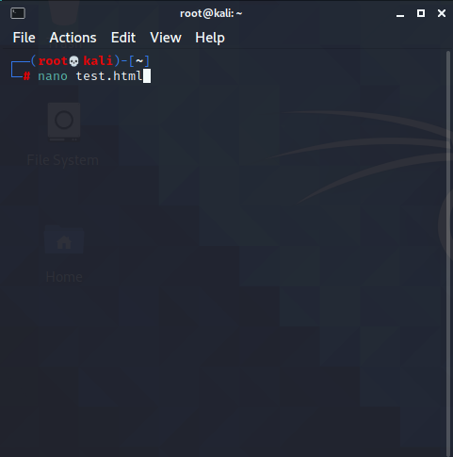

Slide 29
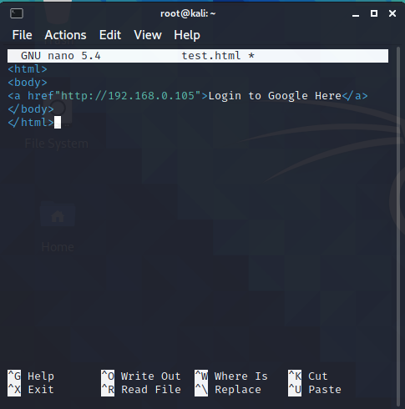

Slide 30
Press ctrl+o for save , then press enter button , then press ctrl+x for close the file.

Slide 31
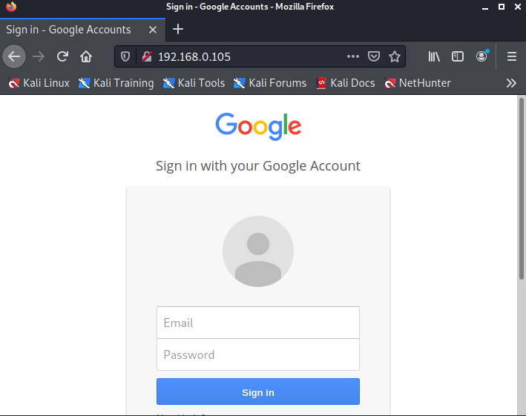

Slide 32
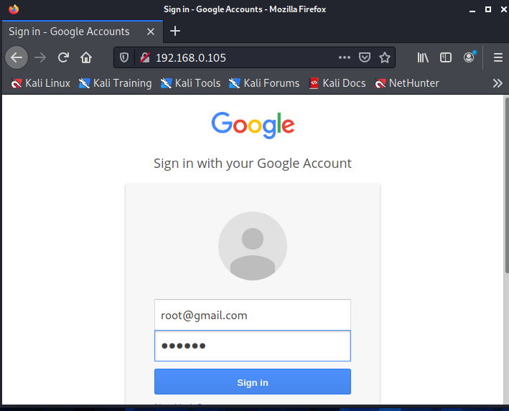

Slide 33
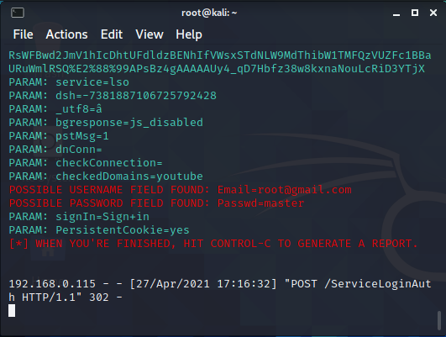

Slide 34
This is how Phishing Attacks happened.

Slide 35
Thanks

